Slide 2
Introduction to Azure Arc-Enabled Data Services
Why everything must be named Ben

Slide 4

Rob Sewell
He/Him
Bearded Consultant
Automator
Trainer
Dual MVP
Consultant Sewells Consulting Ltd
dbatoolsMoL dbachecks
ADSNotebooks PowerShell Community
Data Community
beard.media\book
@sqldbawithbeard
blog.robsewell.com

Slide 5
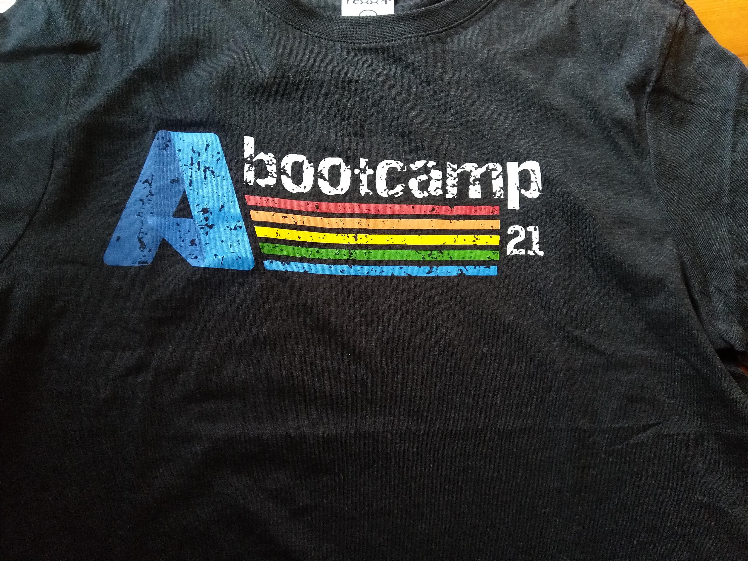


Your chance to win Azure Bootcamp South Africa 2021 Swag from Microsoft and Offerzen!
Apply now: https://aka.ms/azbsaswag2021
Eligible for delivery within South Africa only!

Slide 6
Why Azure Arc-Enabled Data Services?

Slide 7
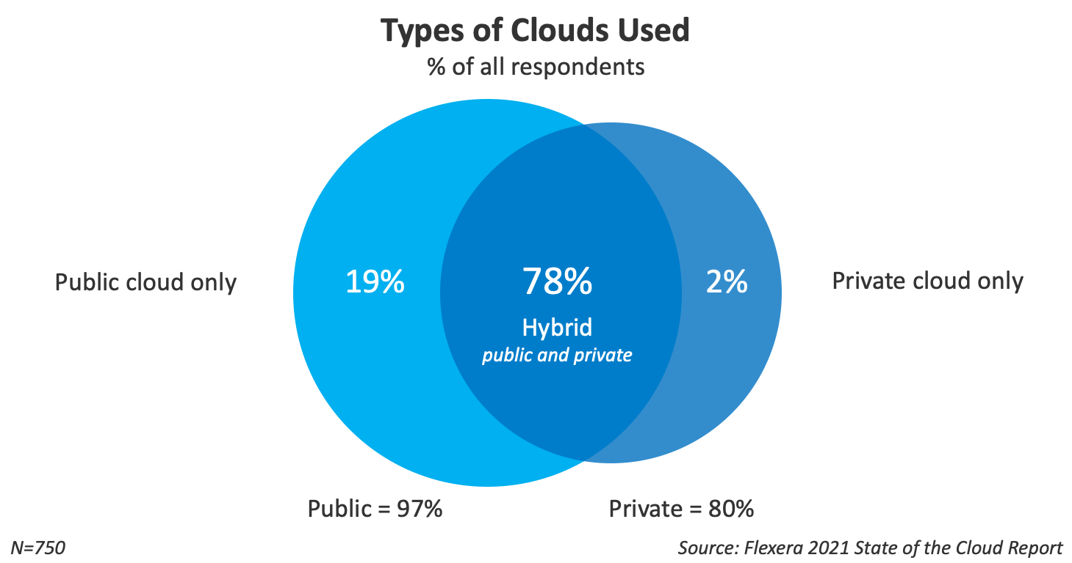

Slide 8
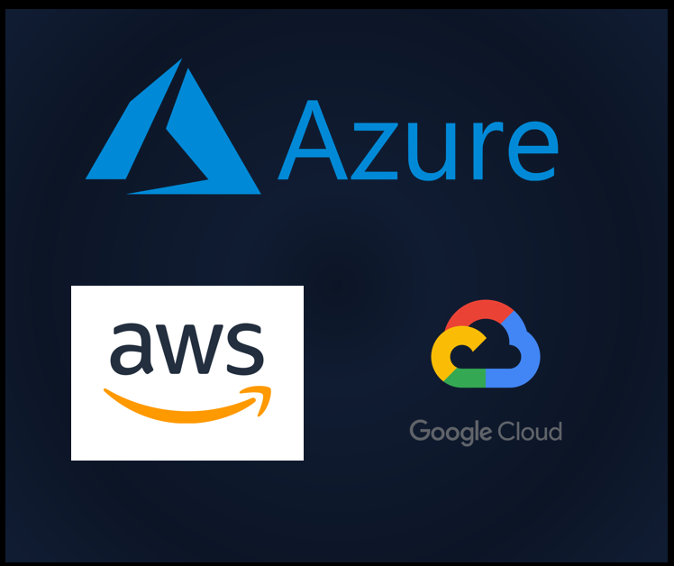

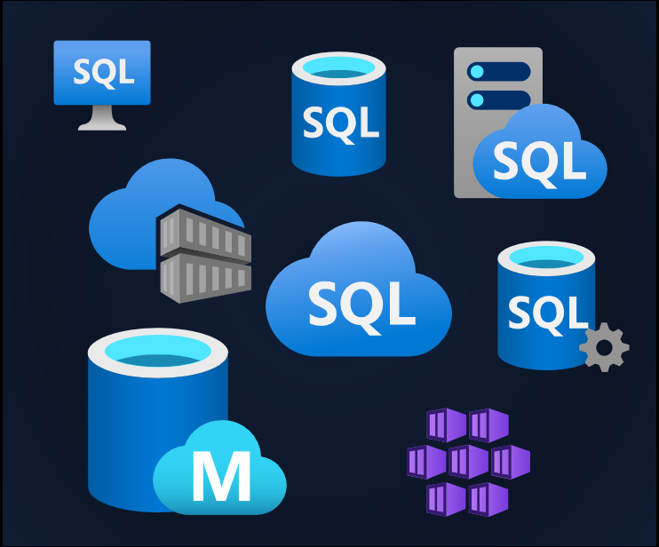
Our Services Are Everywhere

Slide 9


Management is Everywhere
Photo by Ashim D’Silva on Unsplash

Slide 10
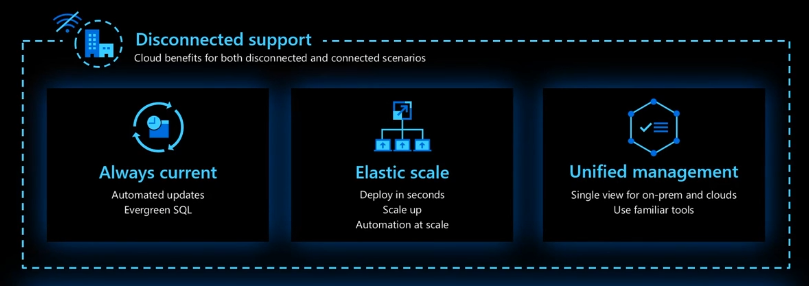

Azure Arc-Enabled Data Services Is Anywhere
Notes:
Azzure Management Services wherever your data services are
Deployments centralised
Operations, loggins, metrics, alerts – cetnralised
Inventory
Unified experience – A quick tools to find!

Slide 11

Azure Arc-Enabled Data Services Is Anywhere

Slide 12
Azure Arc-Enabled Data Services Is Anywhere

Slide 13
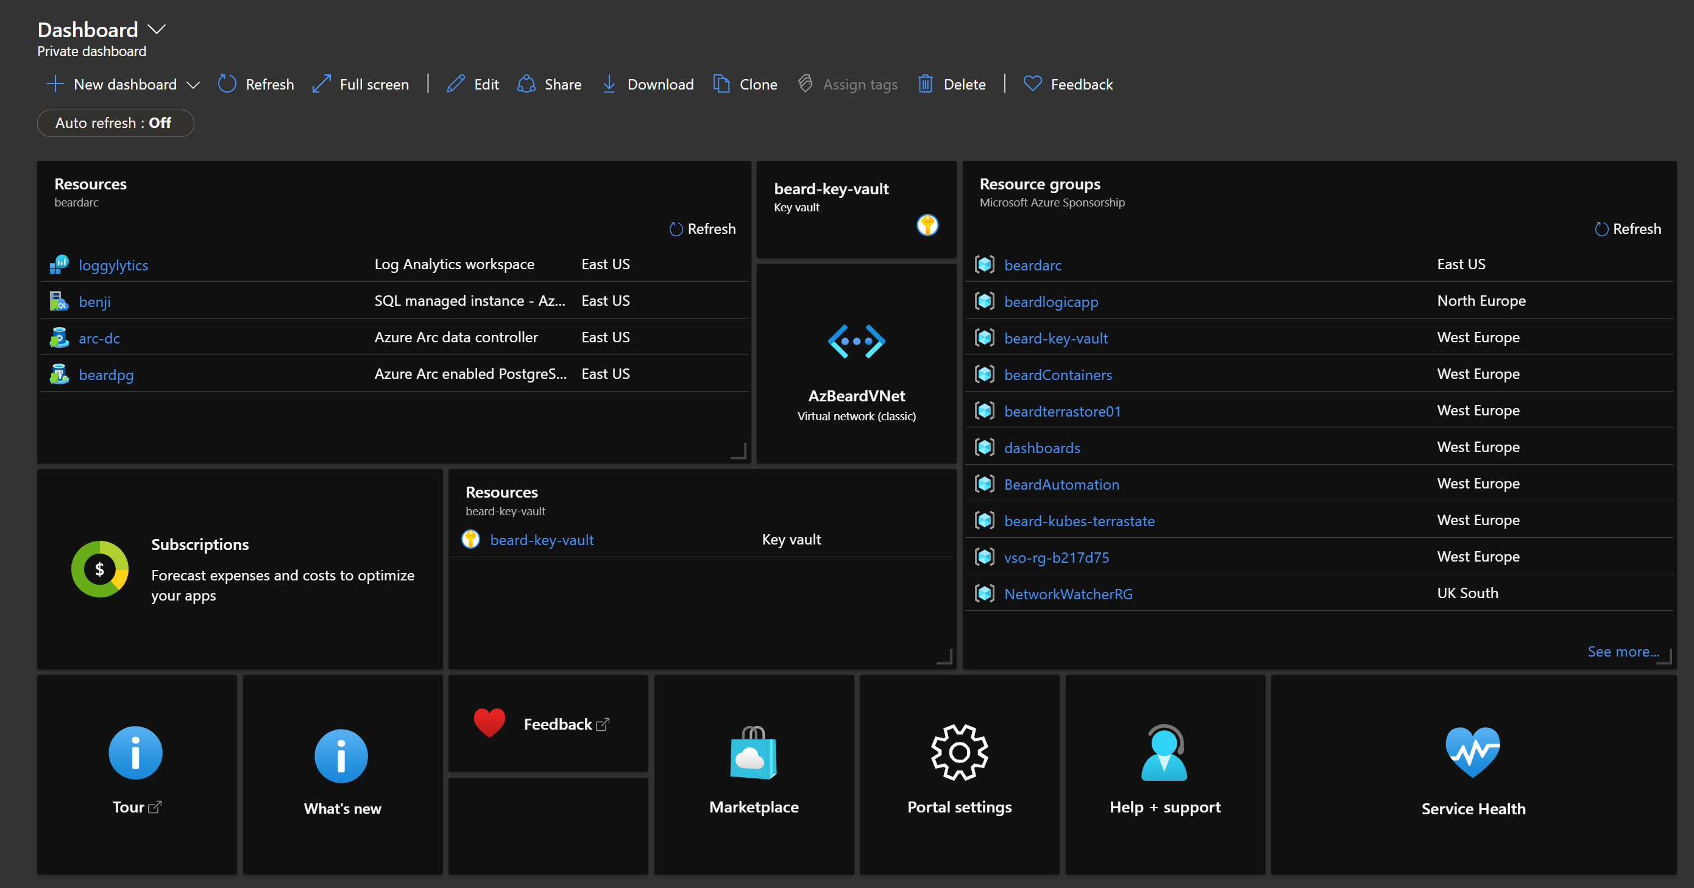
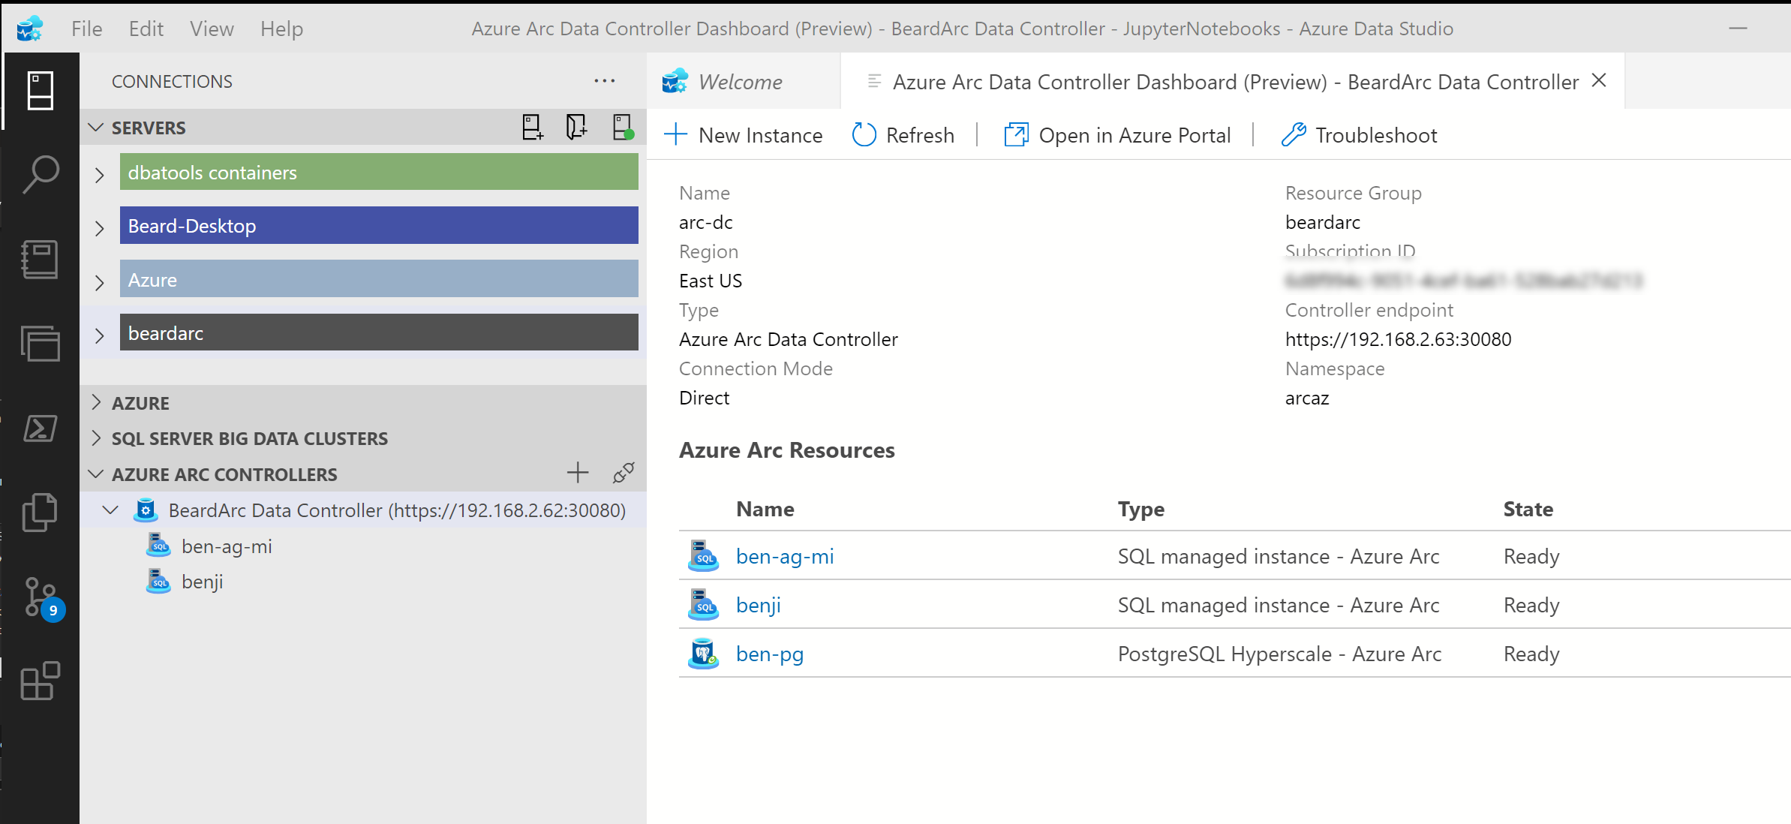
Azure Arc-Enabled Data Services Is Anywhere

Slide 14
Azure Arc-Enabled Data Services Is Anywhere

Slide 15








The Data Controller
Dashboards
Metrics
Logs
Backup/Restore
High Availability
Provisioning
API
Connectivity Modes
Directly Connected
Indirectly Connected
https://docs.microsoft.com/en-us/azure/azure-arc/data/connectivity
Notes:
Provides dashboards, metrics and logging built in
Controls High Availability, automated backup/restore in the plans
Enables Elastic Scale of CPU, RAM and Nodes for Availability Groups

Slide 16


Available Data Services
Azure Arc Enabled SQL Managed Instance
Azure Arc Enabled PostgreSQL Hyperscale
Notes:
Lift and Shift version of SQL Server
Compatible with existing on-prem versions
Single Instance or Availability Group
Elastic Scaling
Open Source POstgreSQL database
Works with existing versions
v11 or v12
Self Service Provisioning using CLI,ADS, Portal, K8s
Always kept up to date (EverGreen)

Slide 17



Deployment
Azure Data Studio
Azure CLI
Kubernetes
With more options planned

Slide 18

Storage
Kubernetes
Decouples the state of the database from the lifecycle of the pods
Persistent Storage allocated from Storage Class
Specify Storage Class for
Data
Logs
App logs

Slide 19
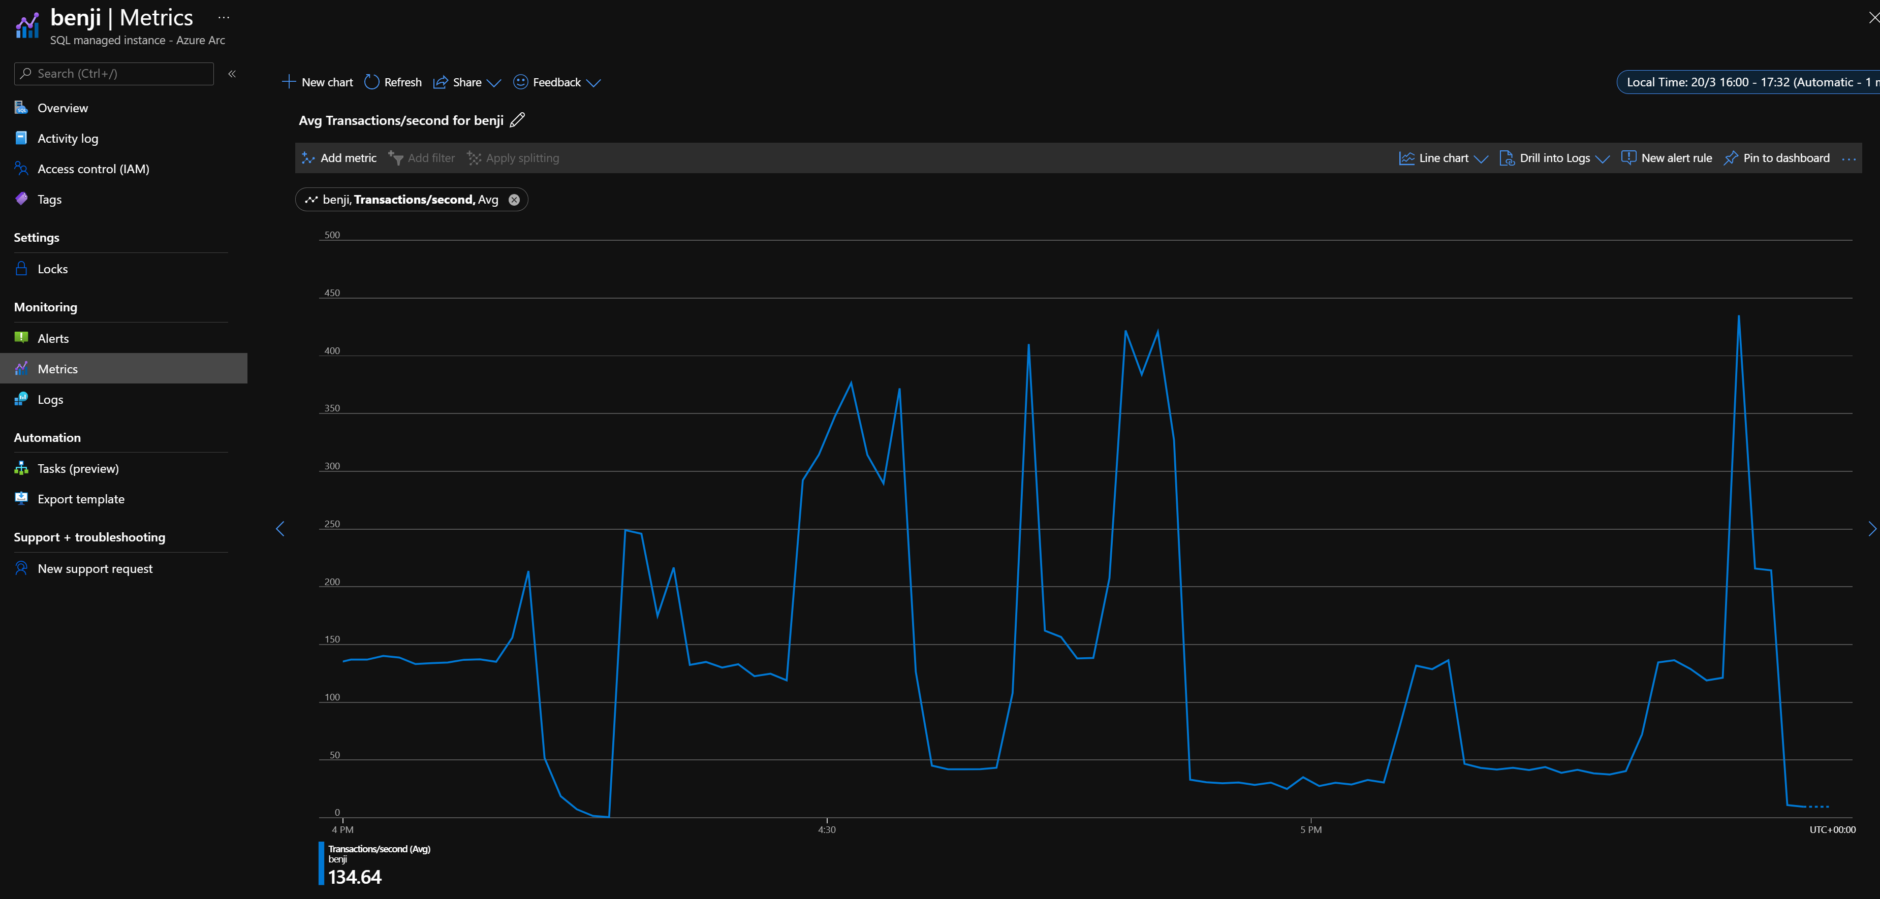
Metrics In the Portal

Slide 20
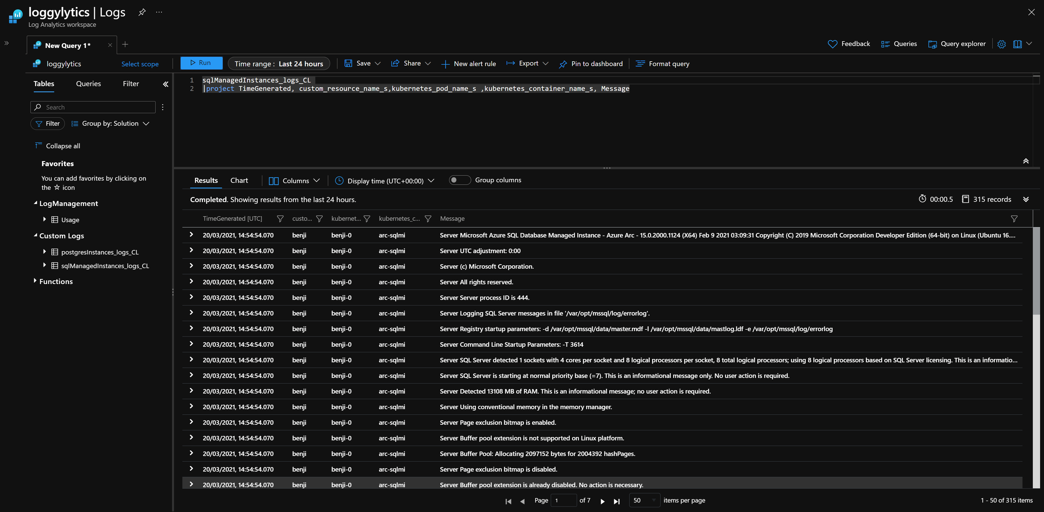
Logs In the Portal

Slide 21
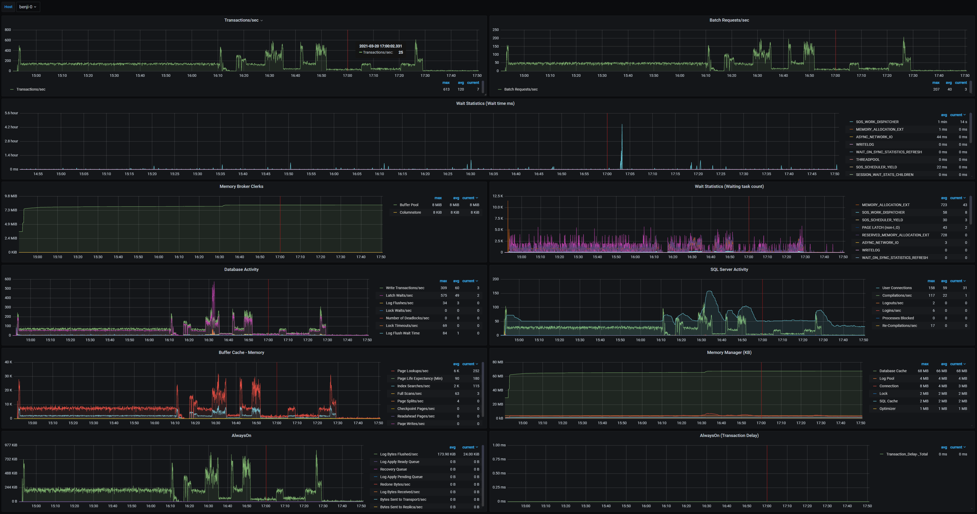
Metrics Built in

Slide 22
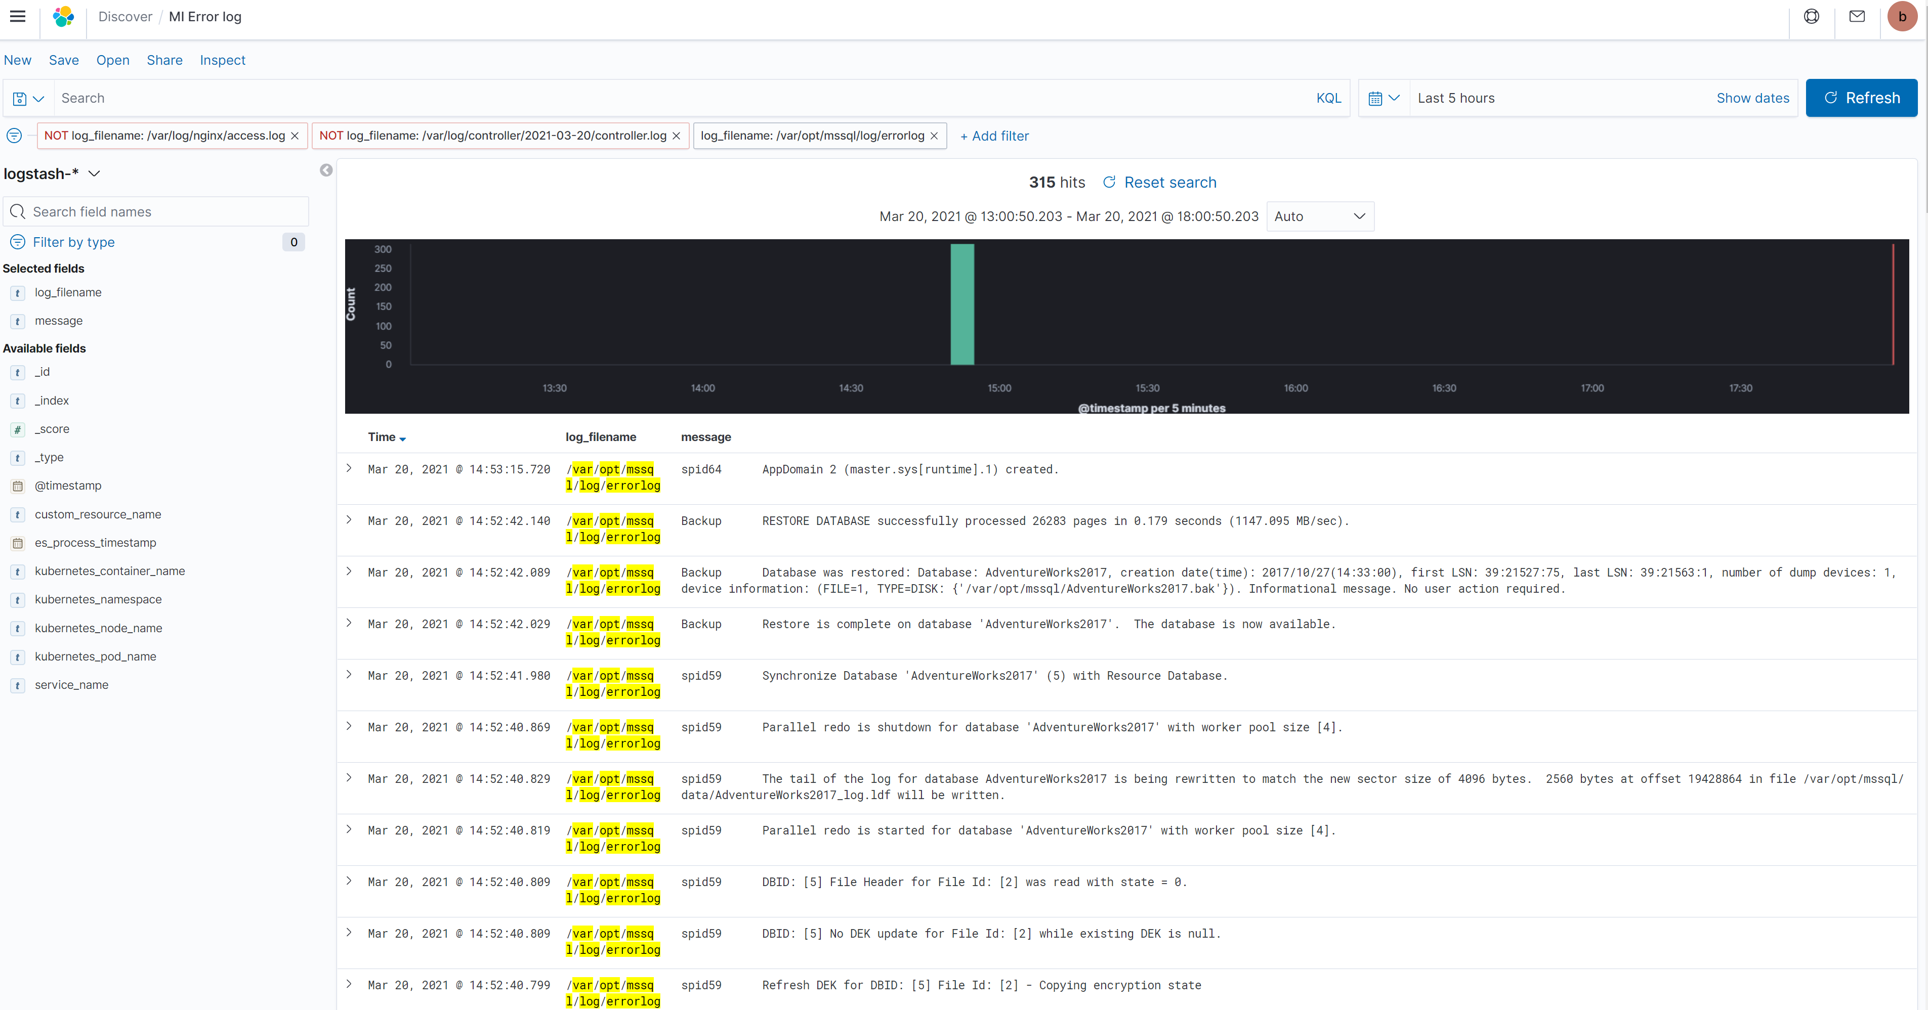
Logs Built in

Slide 23
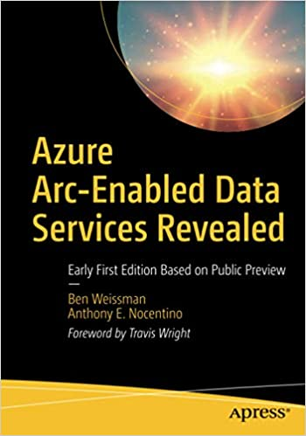
Resources for you
Azure Arc jumpstart
https://azurearcjumpstart.io
Azure Arc enabled data services
https://docs.microsoft.com/en-us/azure/azure-arc/data/
Azure Arc enabled SQL Managed Instance Overview
https://docs.microsoft.com/en-us/azure/azure-arc/data/managed-instance-overview
Azure Arc enabled PostgreSQL Hyperscale
https://docs.microsoft.com/en-us/azure/azure-arc/data/what-is-azure-arc-enabled-postgres-hyperscale
azdata reference
https://docs.microsoft.com/en-us/sql/azdata/reference/reference-azdata

Slide 24
DEMO TIME beard.media/arcdemo

Slide 25
Thank you
@sqldbawithbeard
robsewell.com
beard.media\book

Slide 26








Your chance to win an Xbox Series S and many more prizes from our sponsors!
Enter now: https://aka.ms/azbsaprizes2021
Tweet about the event with the hashtag #AzureBootcampSouthAfrica to add additional entries in the Lucky Draw!
Eligible for delivery within South Africa only!
In Partnership with
Sponsored by

